Slide 1
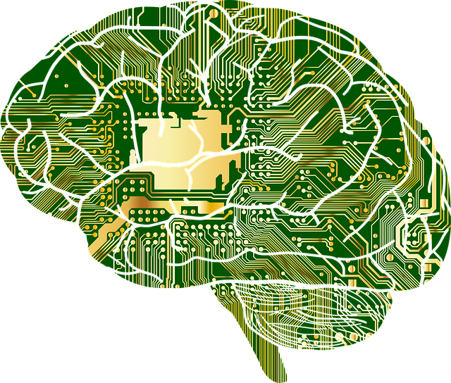

Deep Learning with Neural Nets
#BumblebeeSessions
25 July 2018
© Copyright Bumblebee Consulting 2018

Slide 2
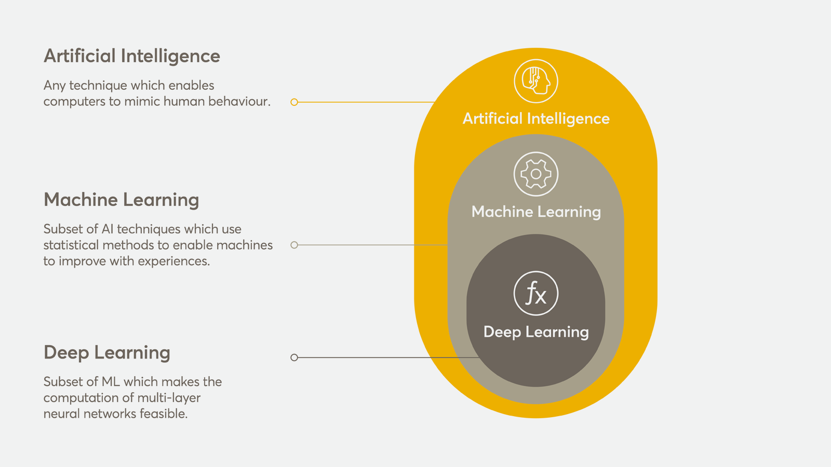
Vast Knowledge Space

Slide 3
Classic Computing Model
Rules
Output
Input

Slide 4
Deep Learning Computing Model
Input
Rules
Output

Slide 5

Neural Networks
Modelled on the human brain
Connects neurons into layers
Start with an input layer
Connect it to hidden layers
Connect the last to an output layer
Use the output layer to predict

Slide 6
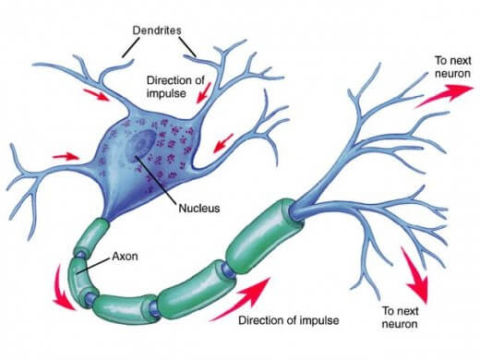
Modelled on the human brain

Slide 7
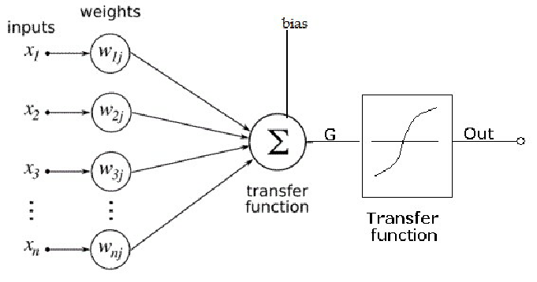
Artificial Neuron

Slide 8
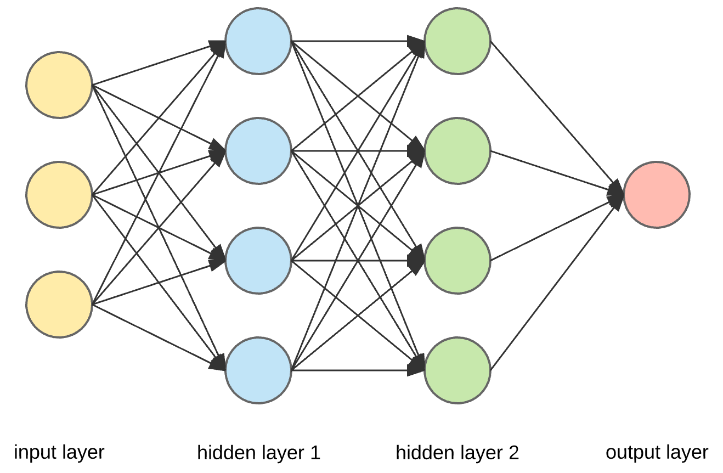
Neural Layers

Slide 9
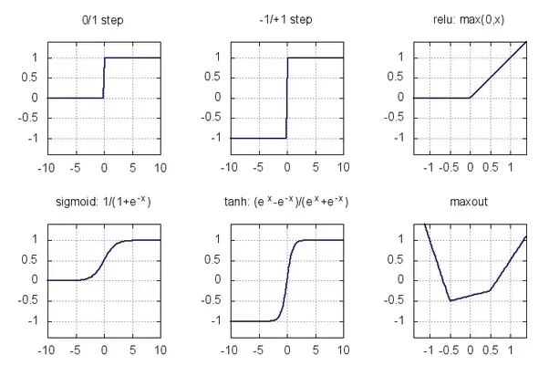
Activation Functions

Slide 10
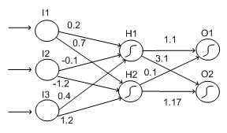
Weights make up the “brain”

Slide 11
Thank You
DEMO

Slide 12
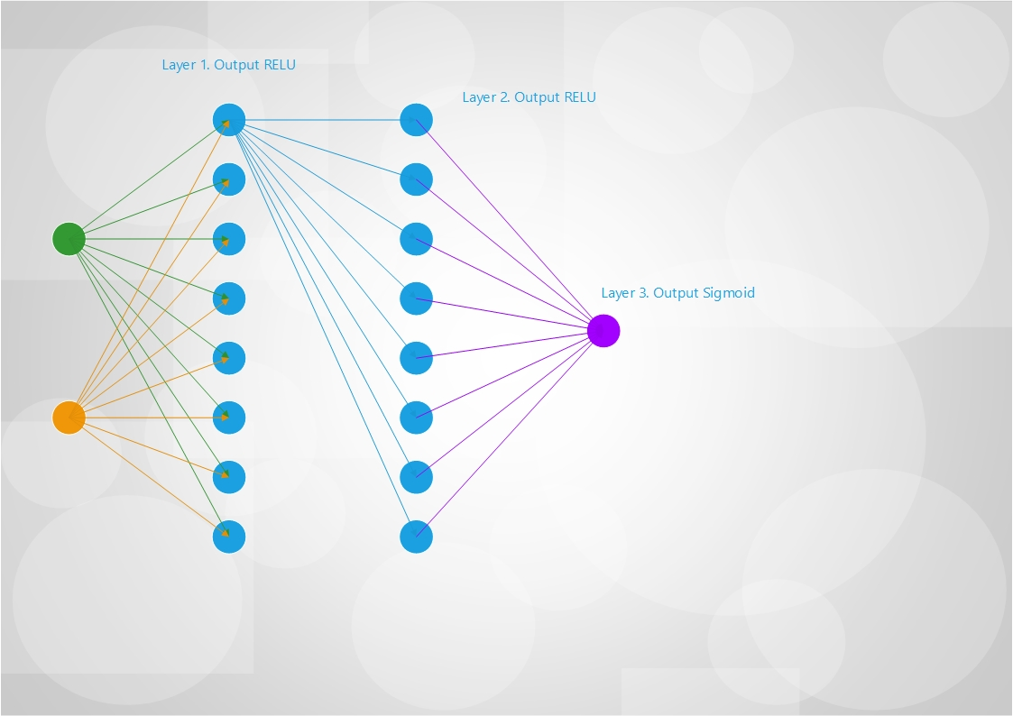
Gate Topology

Slide 13
Further Reading
http://bumbee.co.za
https://github.com/pcfour/deep-learning-presentation

Slide 14
Thank You
Q & A’s
© Copyright Bumblebee Consulting 2018

Slide 15
Thank You
Thank You
© Copyright Bumblebee Consulting 2018

